Slide 1
DATA MINING
(SP22-BL-CSCI-B565-36816)
Opinion Mining in Social Networks for Depression Detection
VISHWAS SHIVAKUMAR vshivak@iu.edu
SAURAV SUBASH PRASAD sasuba@iu.edu
SUSHANT SUJIT MENON ssmenon@iu.edu

Slide 2
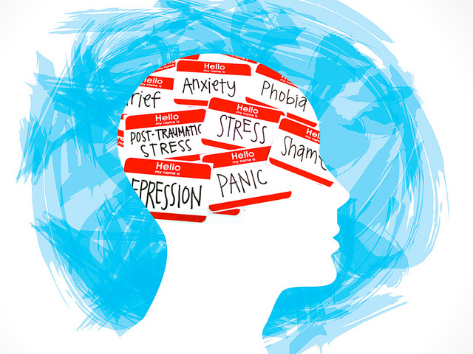
Problem Statement
Depression is a severe medical illness that negatively affects how you feel, how you think and act. It can lead to various emotional and physical problems. Fortunately, depression is treatable. However, treatment for depression is often delayed, imprecise, or missed entirely.
This project contributes to detect depression by utilizing twitter data and proposing different algorithms and comparing their efficiency and performance in a kaggle dataset by using NLP techniques.
Saurav

Slide 3


Real World Problem
DEPRESSION, A Global Public Health Concern
Depression is a significant contributor to the global burden of disease and affects people in all communities across the world. Today, depression is estimated to affect 350 million people. The World Mental Health Survey conducted in 17 countries found that on average about 1 in 20 people reported having an episode of depression in the previous year. Depressive disorders often start at a young age; they reduce people’s functioning and often are recurring. For these reasons, depression is the leading cause of disability worldwide in terms of total years lost due to disability. The demand for curbing depression and other mental health conditions is on the rise globally.

Slide 4
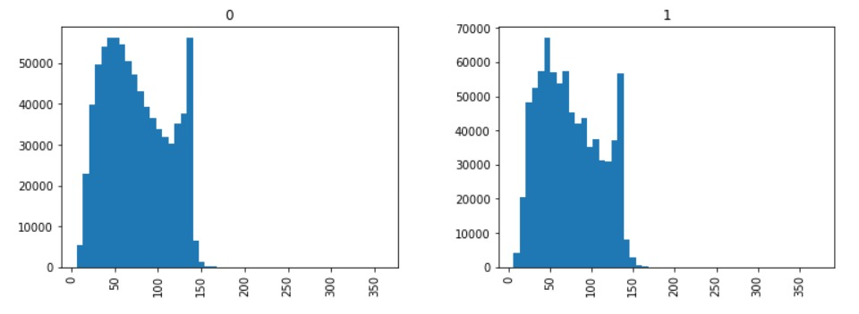
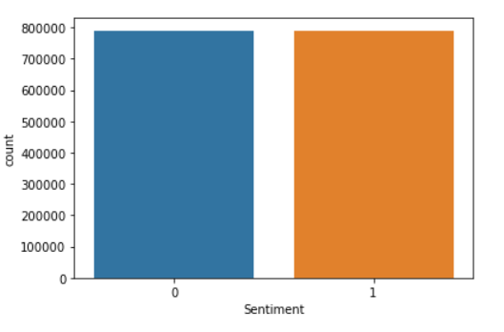
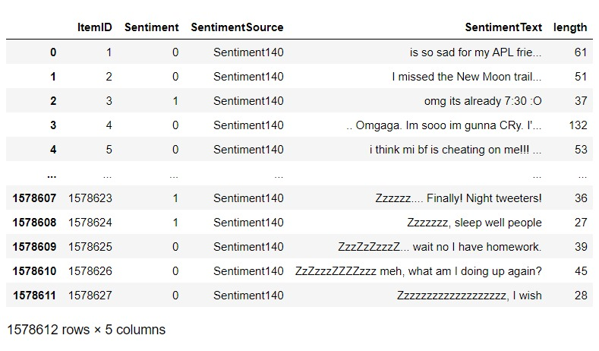
Dataset
The dataset is available on Kaggle. It consists of 15 million tweets that are labeled as tweets that indicate depression or tweets that do not indicate depression. The dataset is unbiased. We have roughly the same number of tweets in each of the two classes.

Slide 5
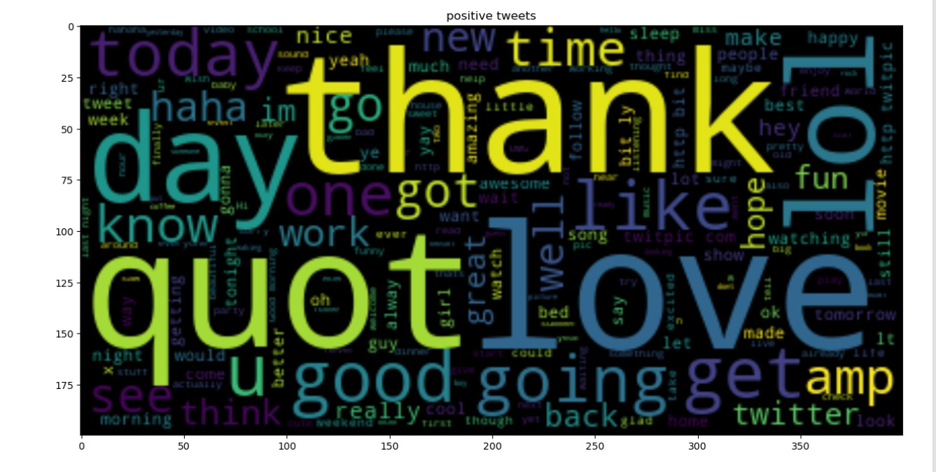
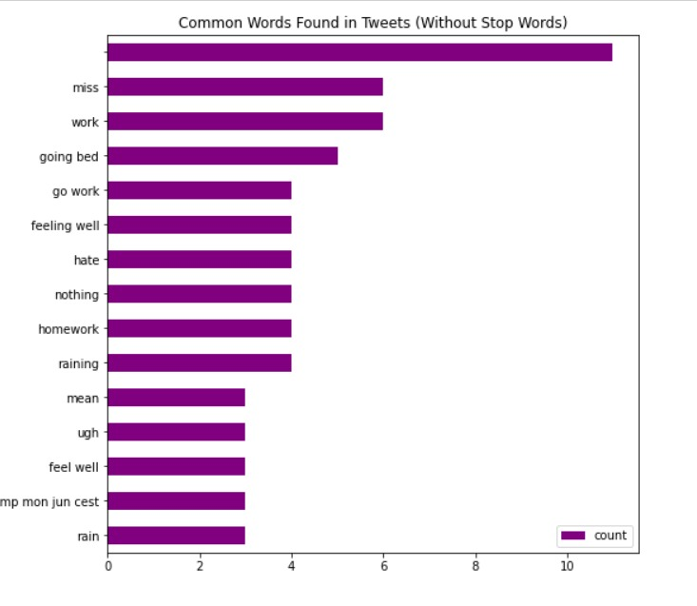
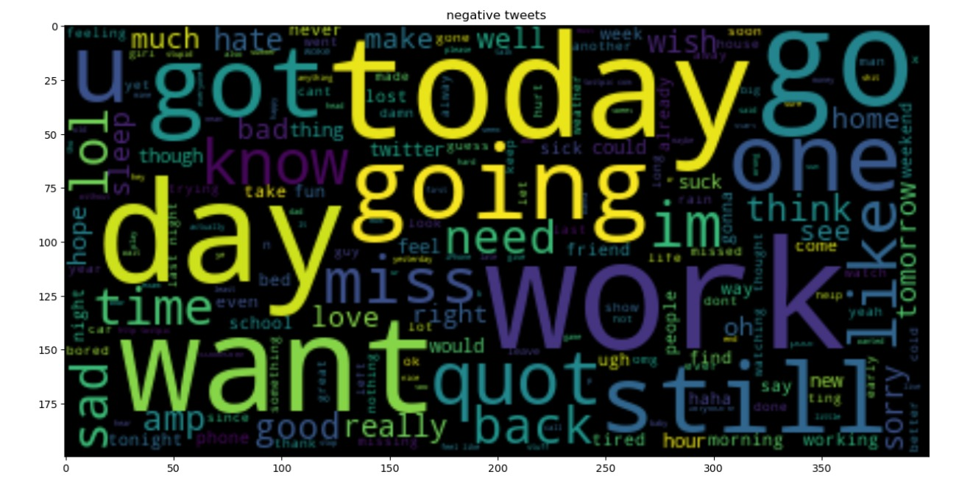
Data Visualization

Slide 6

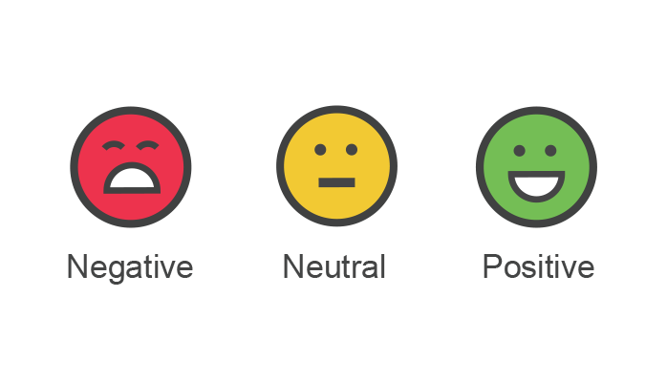
Methodology
We propose building the system on binary classification technique of sentiment classification techniques. In binary classification technique each document di in D where D = {d1, d2, d3, ..... dn} are classified into category C where C = {Positive, Negative} i.e. {Depressed, Not Depressed}. In our proposed methodology, there are four main components that are preprocessing, feature extraction, model selection and accuracy metrics.
Vishwas

Slide 7

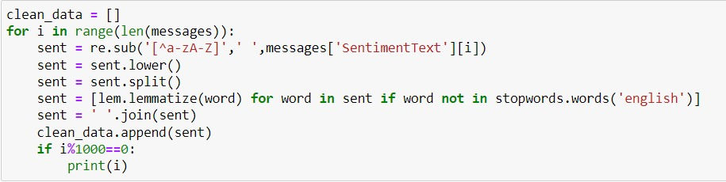
Data Pre-processing
Remove all URLs, hashtags, target words
like (@username)
Remove all the emoticons
Remove all punctuations, symbols, numbers
Remove Stop Words
Remove Non-English Tweets
Vishwas

Slide 8
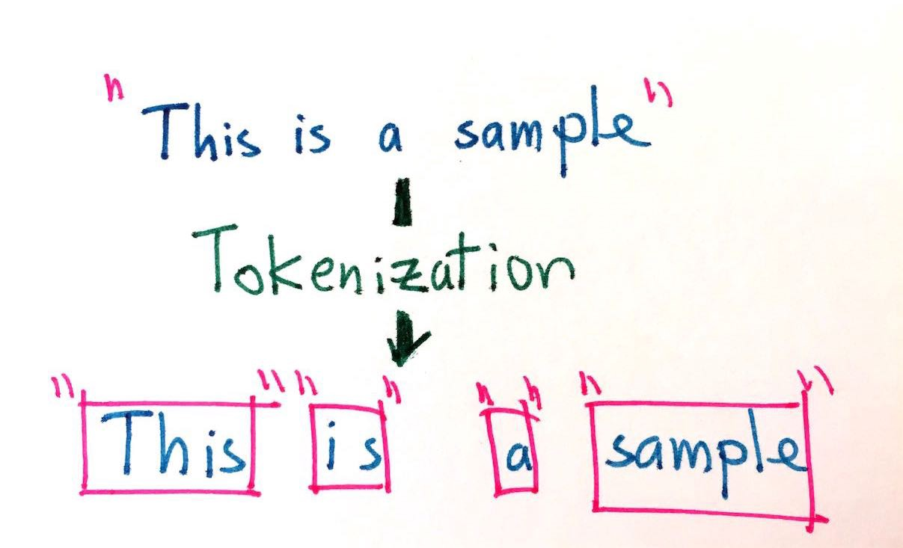
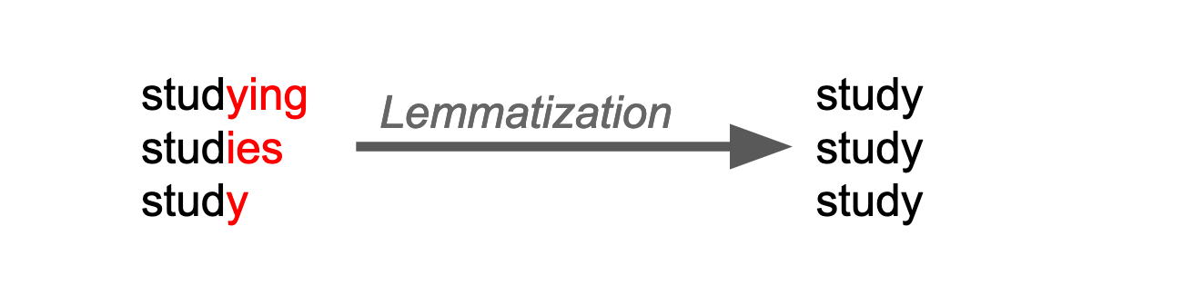
Data Wrangling
Tokenization:- It is the process of breaking a stream of text up into words, symbols and other meaningful elements called “tokens”. It is done so that we can look at the tokens as individual components that form a tweet.
Lemmatization:- Lemmatization usually refers to doing things properly with the use of a vocabulary and morphological analysis of words, normally aiming to remove inflectional endings only and to return the base or dictionary form of a word, which is known as lemmatization. For example, in our case a word such as beautiful will be converted to its root form which is beauty.
Vishwas

Slide 9
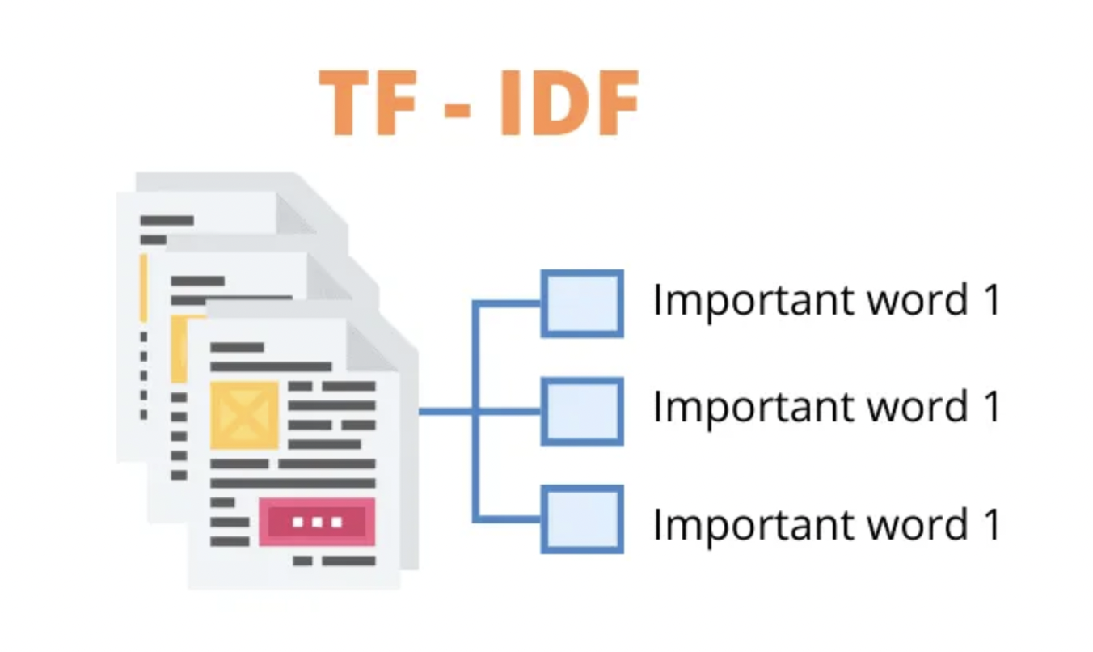
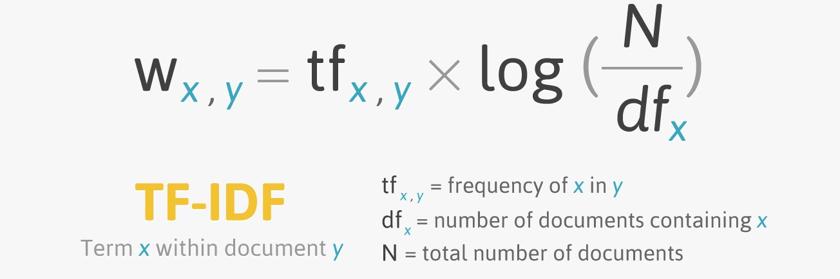
Data Wrangling
Stop Word Removal:- Stop words are a class of some extremely common words which hold no additional information when used in a text and are thus claimed to be useless. Examples include “a”, “an”, “the”, “he”, “she”, “by”, “on”, etc.
Text Vectorization:- Text Vectorization is the process of converting text into numerical representation. To feed in the data to a Machine Learning or Deep learning Model, we have to convert our text data to a numerical representation for our Model to train on.
Bag of Words:- The bag-of-words model is a simplifying representation used in natural language processing and information retrieval (IR).
Vishwas

Slide 10
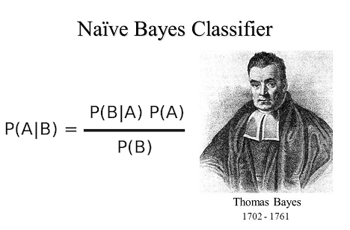
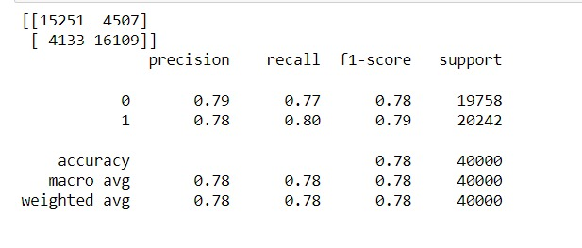

Model - Naive Bayes
Naive Bayes - Naive Bayes classifiers are a family of simple "probabilistic classifiers" based on applying Bayes' theorem with strong (naïve) independence assumptions between the features (see Bayes classifier).
Since a Naive Bayes text classifier is based on the Bayes's Theorem, which helps us compute the conditional probabilities of occurrence of two events based on the probabilities of occurrence of each individual event, encoding those probabilities is extremely useful.

Slide 11
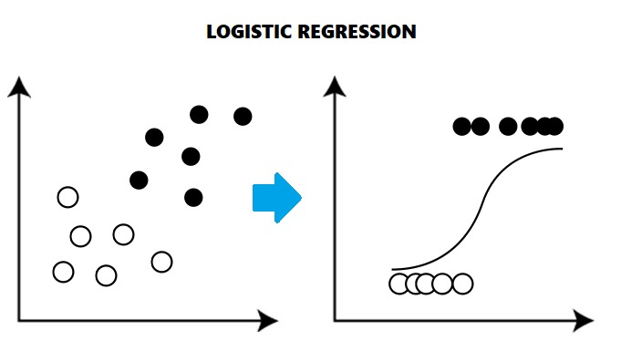
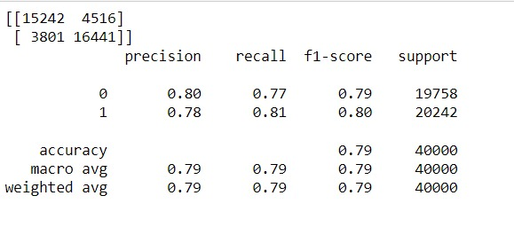
Model - LR
Logistic regression is a statistical model that in its basic form uses a logistic function to model a binary dependent variable. Logistic regression is a process of modeling the probability of a discrete outcome given an input variable. The most common logistic regression models a binary outcome; something that can take two values such as true/false, yes/no, and so on. the function that converts log-odds to probability is the logistic function, hence the name.

Slide 12
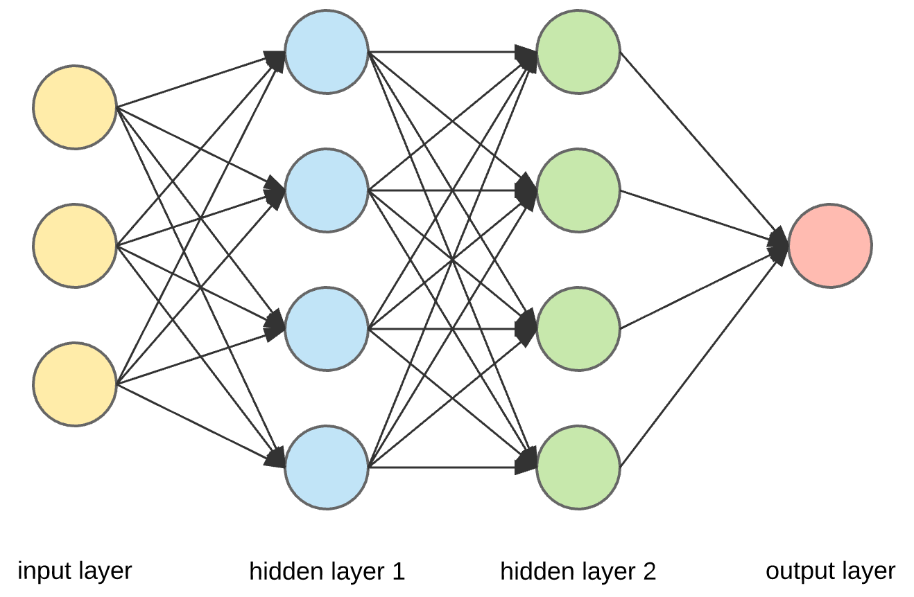
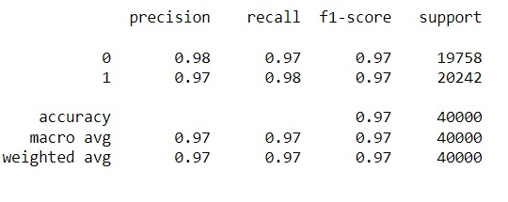
Model - ANN
Artificial Neural Network is a collection of connected units or nodes called artificial neurons, which loosely model the neurons in a biological brain. The "signal" at a connection is a real number, and the output of each neuron is computed by some non-linear function of the sum of its inputs. The connections are called edges. Neurons and edges typically have a weight that adjusts as learning proceeds. The weight increases or decreases the strength of the signal at a connection.
Neurons are aggregated into layers. Different layers may perform different transformations on their inputs. Signals travel from the first layer (the input layer), to the last layer (the output layer), possibly after traversing the layers multiple times.

Slide 13
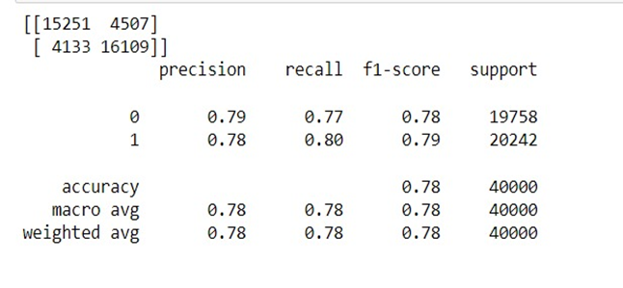
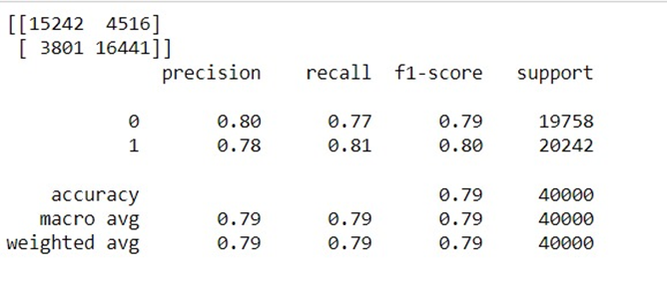
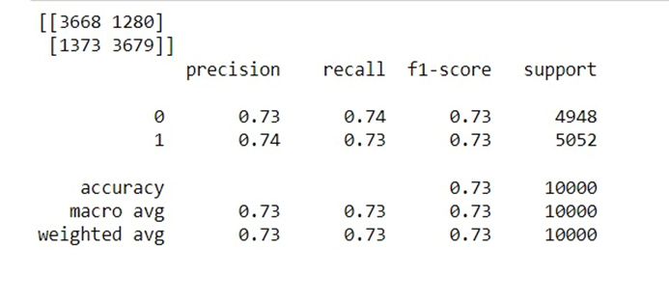
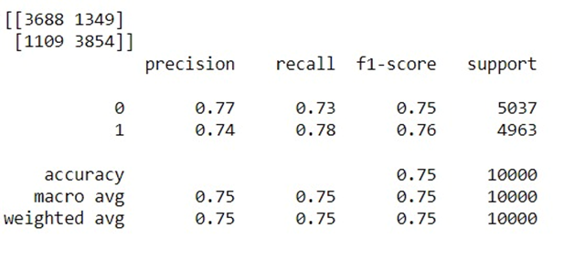
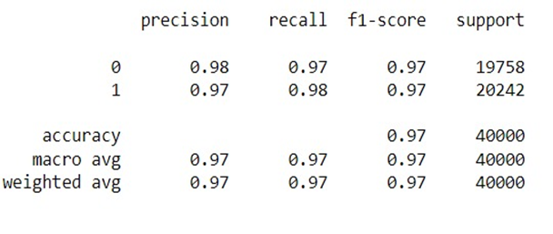
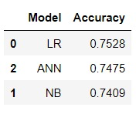
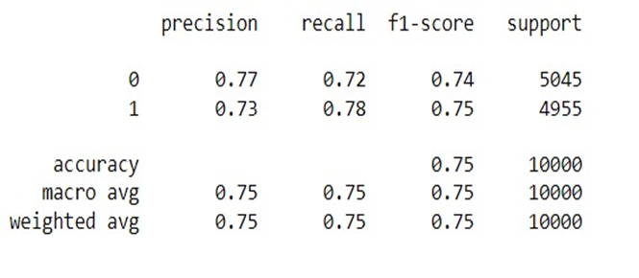
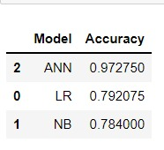
Key Results
Naïve Bayes Logistic Regression
ANN

Slide 14
Citations and Acknowledgements
Banitaan, Shadi, and Kevin Daimi. ”Using data mining to predict possible future depression cases.” International Journal of Public Health Science (IJPHS) 3.4 (2014): 231-240.
Hussain, Jamil, Maqbool Ali, Hafiz Syed Muhammad Bilal, Muhammad Afzal, Hafiz Farooq Ahmad, Oresti Banos, and Sungyoung Lee. ”SNS based predictive model for depression.” In International Conference on Smart Homes and Health Telematics, pp. 349-354. Springer, Cham, 2015.
T. Al-Moslmi, N. Omar, S. Abdullah and M. Albared, "Approaches to Cross-Domain Sentiment Analysis: A Systematic Literature Review," in IEEE Access, vol. 5, pp. 16173-16192, 2017.
R. Mehra, M. K. Bedi, G. Singh, R. Arora, T. Bala and S. Saxena, "Sentimental analysis using fuzzy and naive bayes," In Proc. of the 2017 Int. Conf. on Computing Methodologies and Communication (ICCMC), Erode, 2017, pp. 945-950.
S. Liu, X. Cheng, F. Li and F. Li, "TASC:Topic-Adaptive Sentiment Classification on Dynamic Tweets," IEEE Transactions on Knowledge and Data Engineering, vol. 27, no. 6, pp. 1696-1709, 1 June 2015.
Braithwaite, Scott R., et al. ”Validating machine learning algorithms for twitter data against established measures of suicidality.” JMIR mental health 3.2 (2016).
Xiaohui Tao, Ravi Dharmalingam, Ji Zhang, Xujuan Zhou, Lin Li, and Raj Gururajan “Twitter Analysis for Depression on Social Networks based on Sentiment and Stress.”
Anastasia Giachanou and Fabio Crestani. Like it or not: A survey of twitter sentiment analysis methods. ACM Comput. Surv., 49(2):28:1– 28:41, June 2016.

Slide 15
Thank You!

